Slide 1

Synchronous programming with multiprocessing

Slide 2
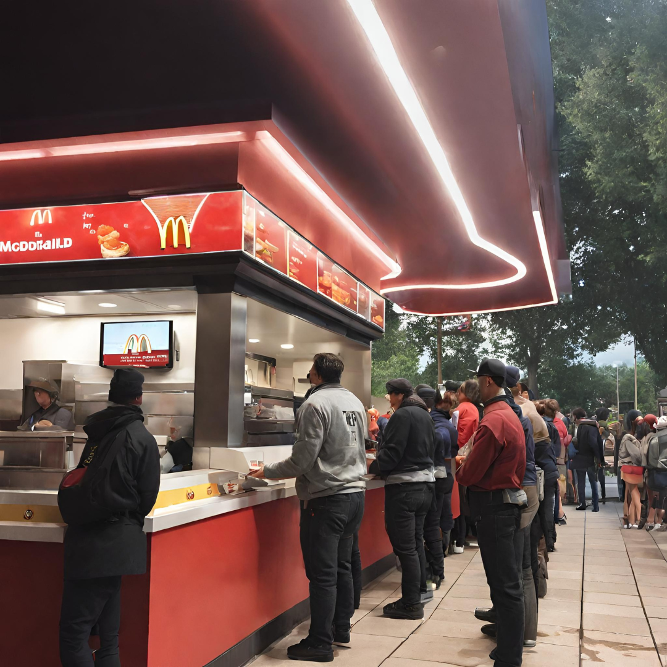
Asynchronous Programming

Slide 3
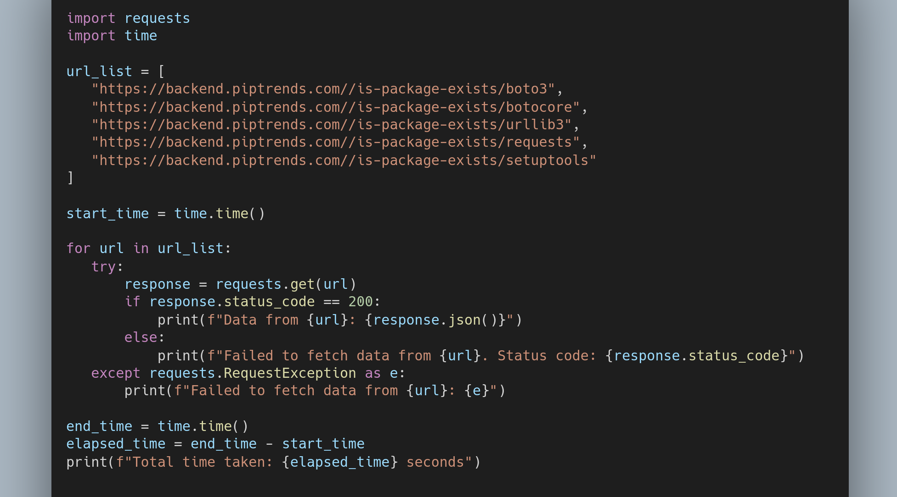
Synchronous code

Slide 4
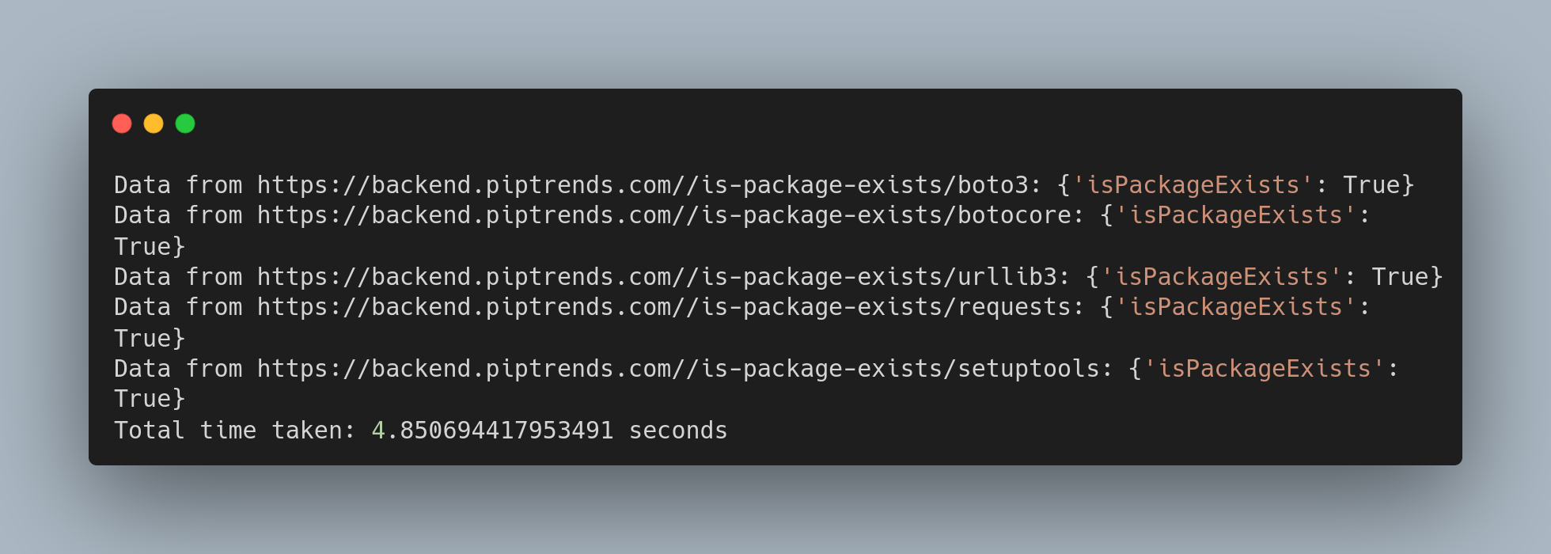
Output

Slide 5
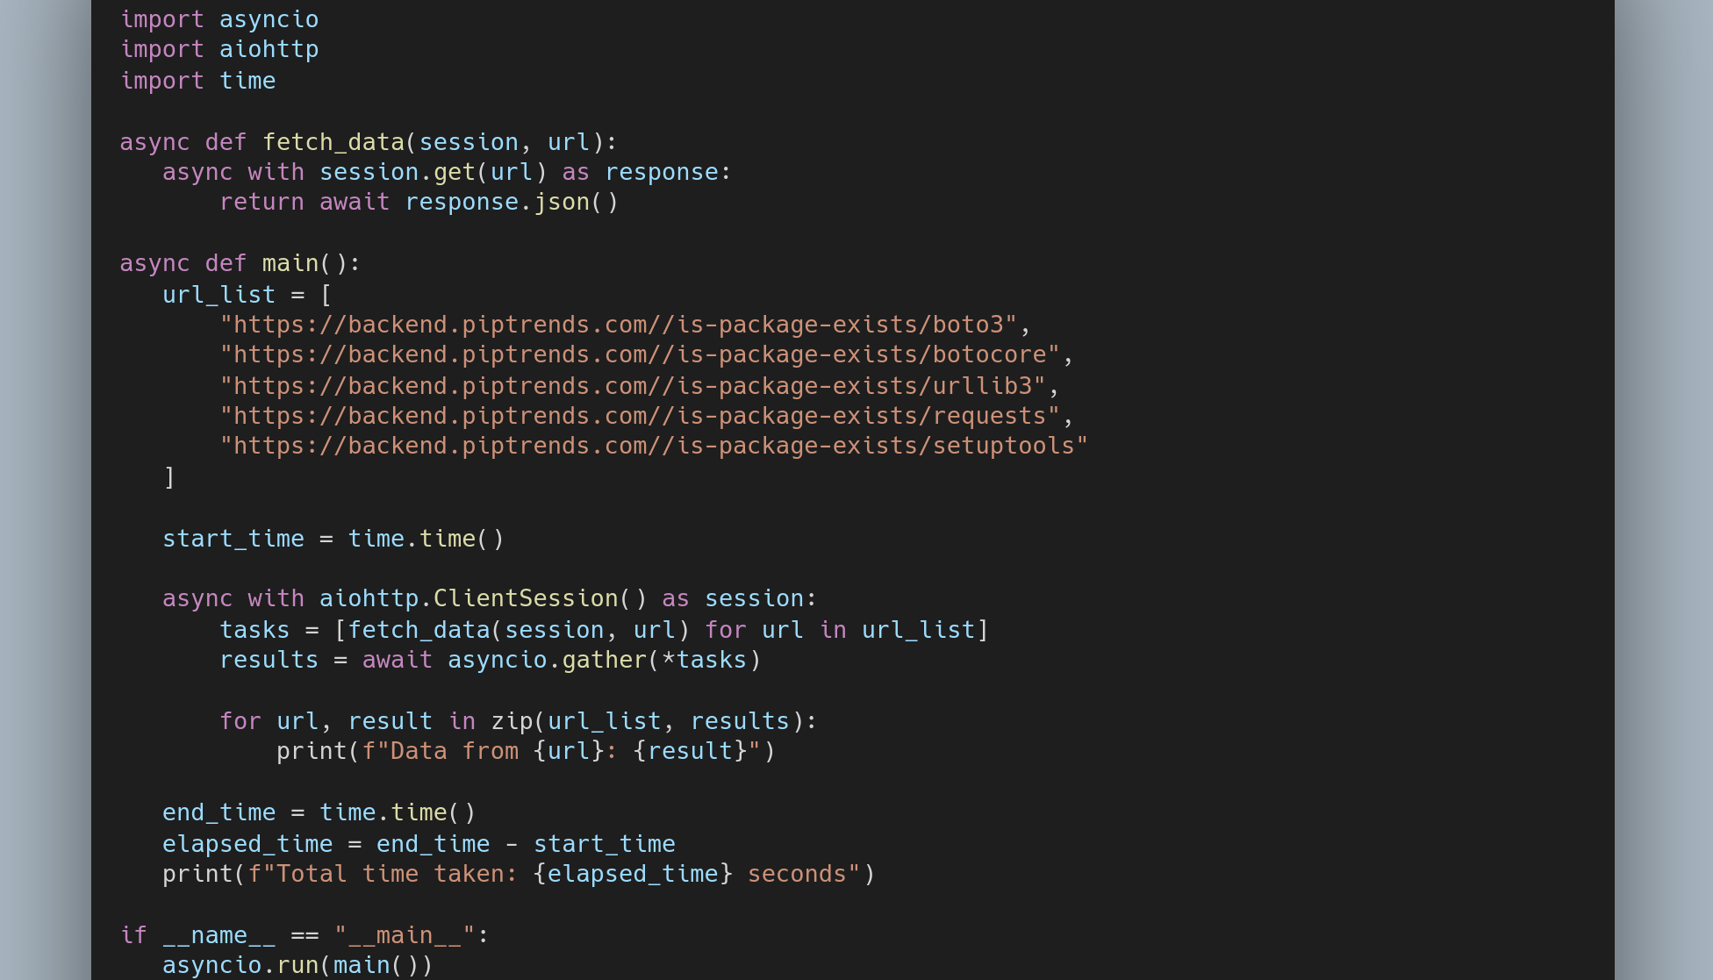
Asynchronous code

Slide 6

Output

Slide 7

Hello! My name is Ashok Tankala
I am a Freelance CTO
Building pipTrends.com
I love Coding & Teaching.

Slide 8

2 Myths about asyncio
asyncio is a kind of multiprocessing or threads
asyncio is difficult

Slide 9
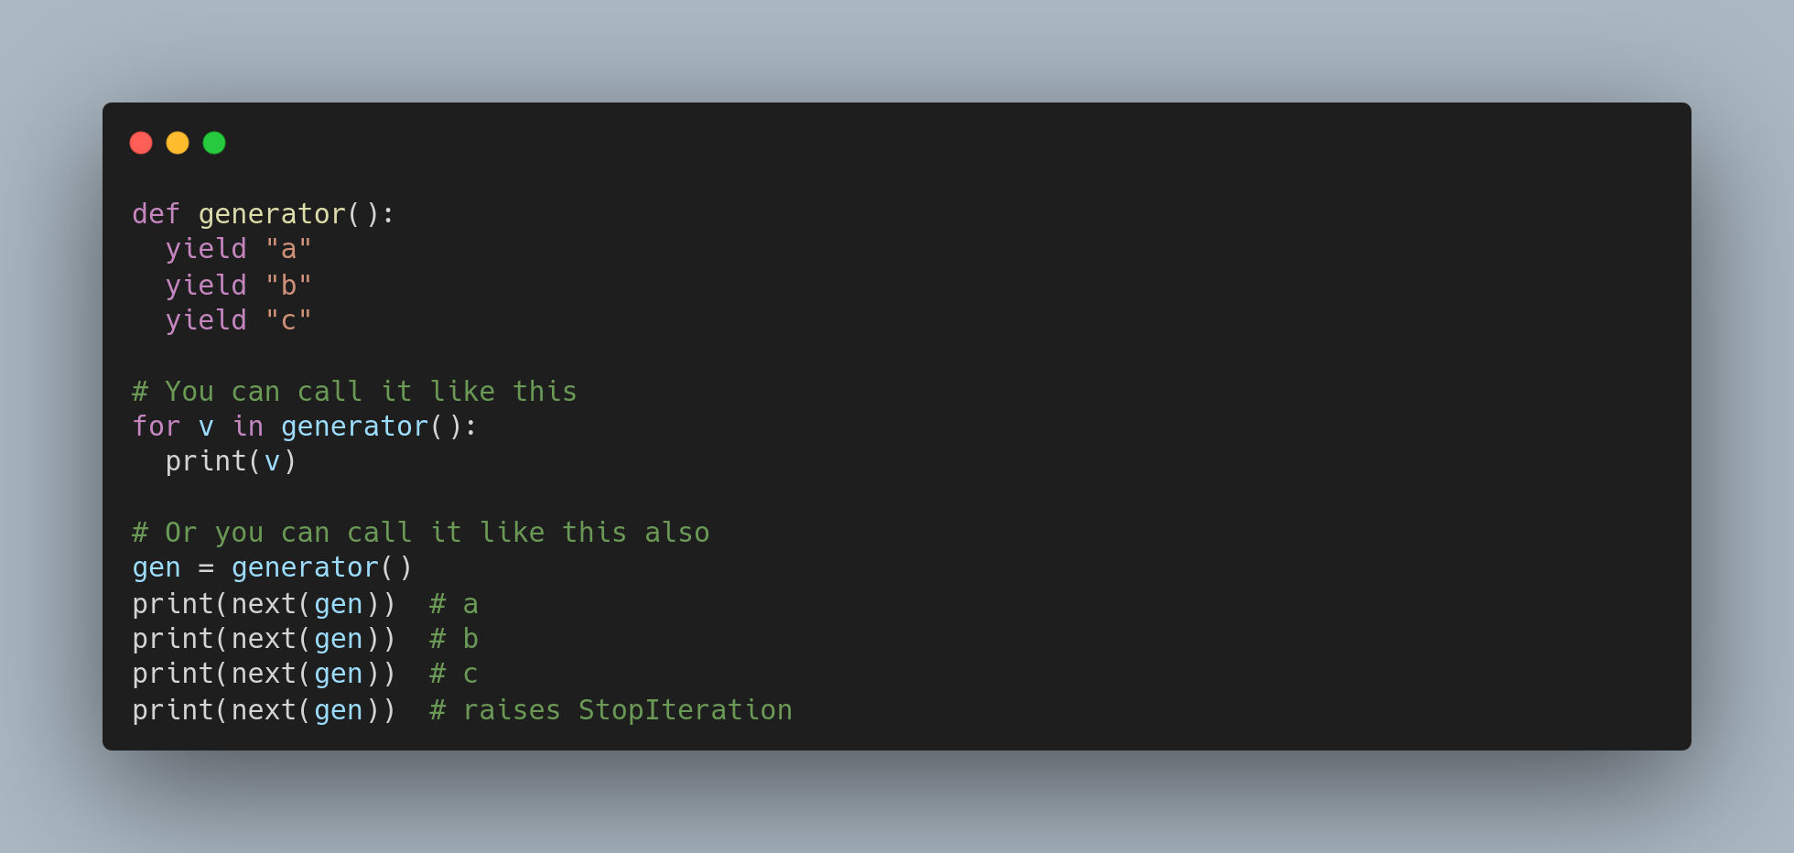
Generator

Slide 10
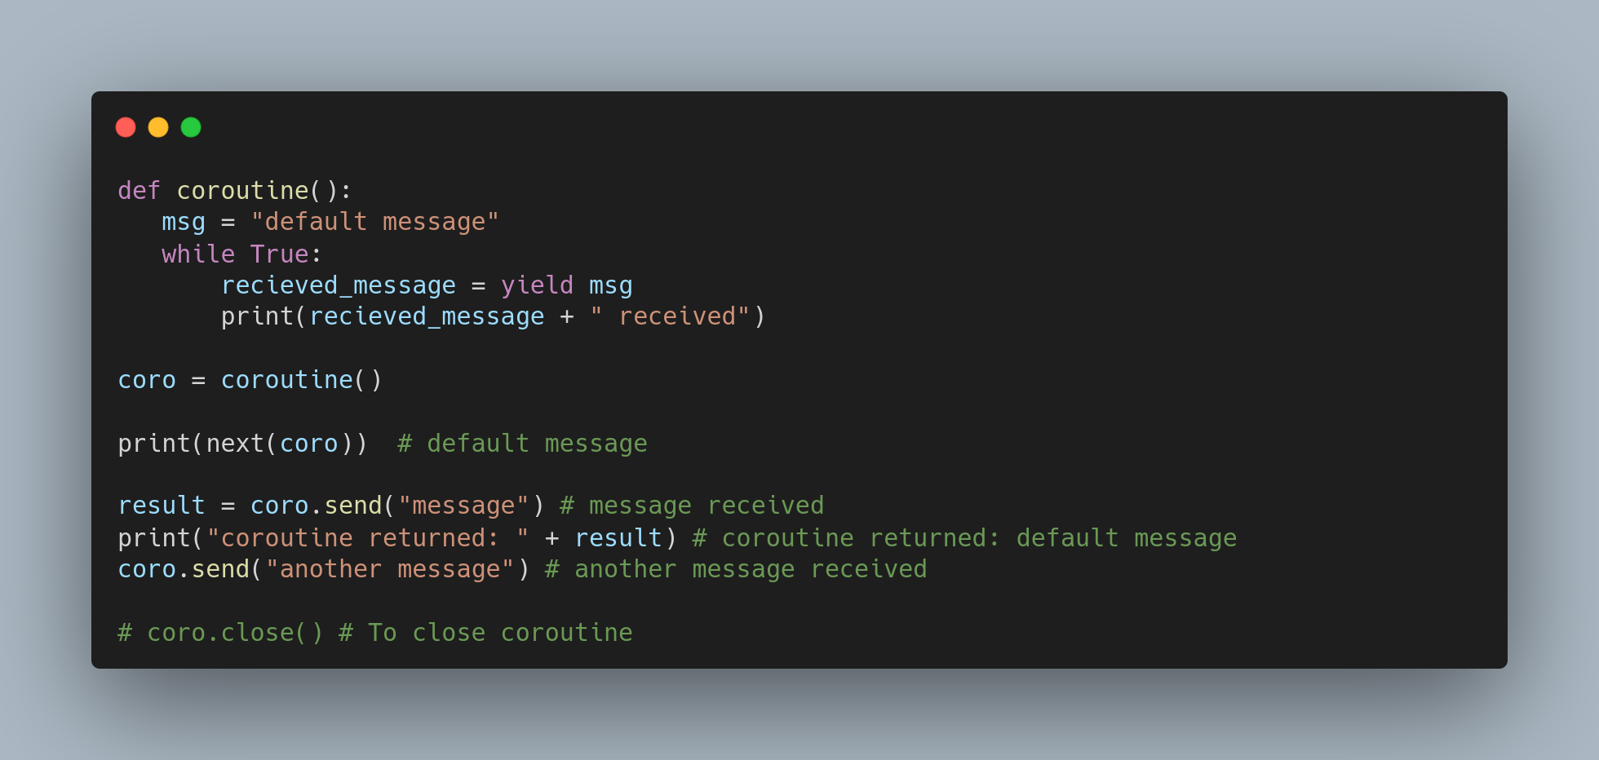
Coroutine

Slide 11

Let's get our hands dirty & learn asyncio

Slide 12

Questions/Feedback

